Slide 1
SQL Mini Capstone Project
By Jennifer Lopez

Slide 2
INTRODUCTION TO DATA AND DATABASES
PROJECT
Create a Videos table.
This table should include a unique ID, the title of the video, the length in minutes, and the URL.
Populate the table with at least three SQL educational videos from YouTube or other publicly available resources.

Slide 3
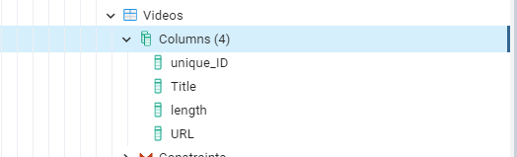
Query & Results: Create a Table- Videos
CREATE TABLE Videos (
Unique_ID BIGSerial NOT NULL PRIMARY KEY,
title VARCHAR(50) NOT NULL,
length TIME NOT NULL,
URL VARCHAR(255) NOT NULL);

Slide 4
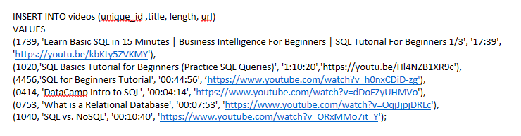
Query: Insert Videos from YOUTUBE or Other sources

Slide 5
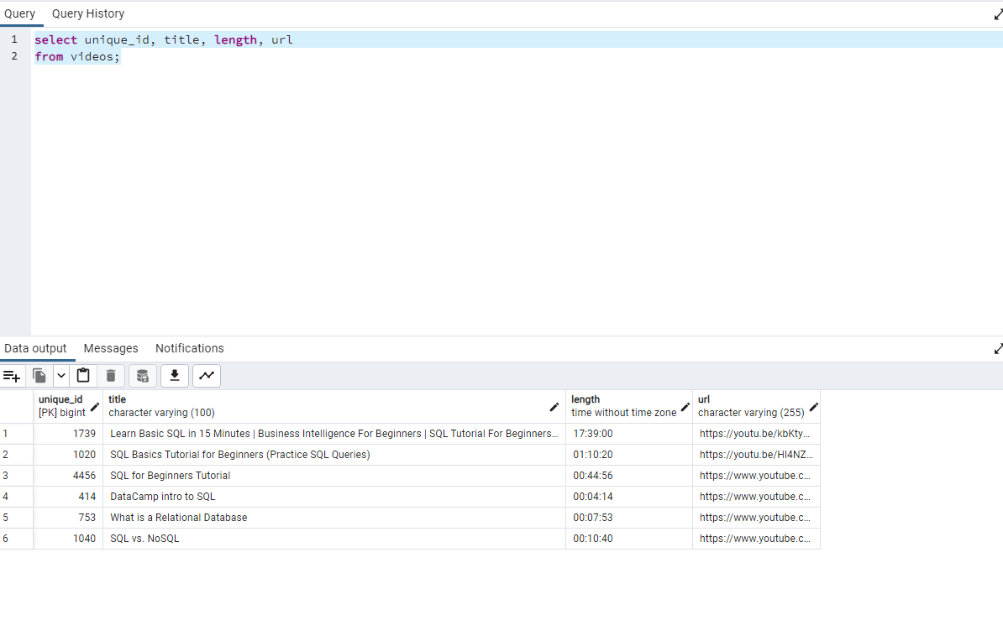
Running Query after Insertion of Videos

Slide 6
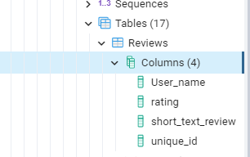
QUERY: CREATING REVIEWS TABLE
CREATE TABLE Reviews (
Unique_ID BIGSerial NOT NULL PRIMARY KEY,
user_name VARCHAR(150) NOT NULL,
rating NUMERIC NULL,
short_text_review VARCHAR(255) NOT NULL) ;

Slide 7
Query: Insert Unique_ID, User_name,Rating, short_text_review
INSERT INTO Reviews (unique_id ,user_name, rating, short_text_review)
VALUES
(1739, 'James Mardsen', '5', 'loved it'),
(1020,'Kenny Yu','4', 'fair to watch'),
(4456,'Madison Clair', '3', 'too long'),
(0414, 'Carlos Sanchez', '5', 'loved it'),
(0753, 'Habiba Mohinder', '2', 'boring'),
(1040, 'Tyson Bailey', '4', 'fair to watch');

Slide 8
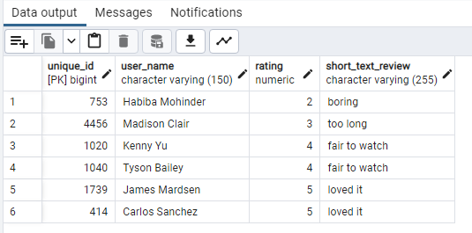
Run the Query after Insertion of Data : Reviews Table Results
SELECT unique_id,user_name,rating, short_text_review
FROM Reviews
ORDER BY rating ASC;

Slide 9
Report on video reviews.
Unique_Ids: 1739 and 414 have the best ratings according to users James Marsden & Carlos Sanchez with a short text reviewed that they loved watching the videos. And Unique_id 753 with the most boring video according to Habiba Mohinder with a rating of 2.

Slide 10
JOIN statement that shows information from both tables in one query/report.
SELECT Videos.unique_ID, Reviews.rating, Videos.title, videos.length
FROM videos
INNER JOIN reviews ON Videos.unique_ID = Reviews.Unique_id
Order by rating ASC;

Slide 11
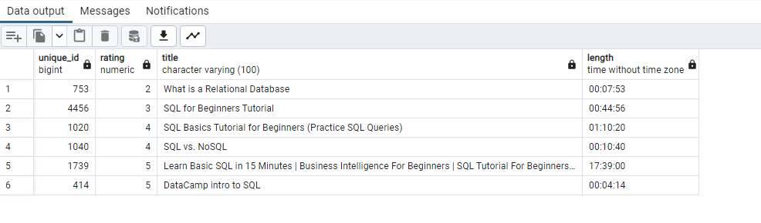
Findings after JOINING the Videos & Reviews Tables
After running the query ,I observed that the top 2 videos with the best ratings were “Learn Basic SQl in 15 min…”, and “DataCamp intro to SQL’’ and the least rated was “What is a Relational Database” in which rating was not based on the length of the video but based on the content of it.

